Slide 1
Chapter 6
Some Continuous Probability Distributions
Chapter 6
Some Continuous Probability Distributions

Slide 2
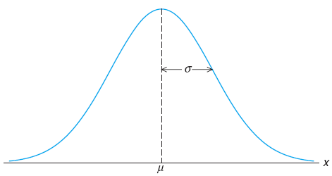
Chapter 6.2
Normal Distribution
Normal Distribution
Normal distribution is the most important continuous probability distribution in the entire field of statistics.
Its graph, called the normal curve, is the bell-shaped curve which describes approximately many phenomena that occur in nature, industry, and research.
The normal distribution is often referred to as the Gaussian distribution, in honor of Karl Friedrich Gauss, who also derived its equation from a study of errors in repeated measurements of the same quantity.
The normal curve

Slide 3
Chapter 6.2
Normal Distribution
Normal Distribution
A continuous random variable X having the bell-shaped distribution as shown on the figure is called a normal random variable.
The density function of the normal random variable X, with mean μ and variance σ², is
where π = 3.14159... and e = 2.71828...

Slide 4
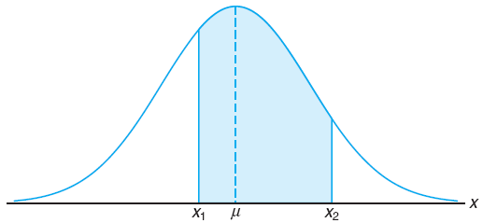
Chapter 6.3
Areas Under the Normal Curve
Area Under the Normal Curve
The area under the curve bounded by two ordinates x = x₁ and x = x₂ equals the probability that the random variable X assumes a value between x = x₁ and x = x₂.

Slide 5
Chapter 6.3
Areas Under the Normal Curve
Area Under the Normal Curve
The difficulty encountered in solving integrals of normal density functions necessitates the tabulation of normal curve area for quick reference.
Fortunately, we are able to transform all the observations of any normal random variable X to a new set of observation of a normal random variable Z with mean 0 and variance 1.

Slide 6
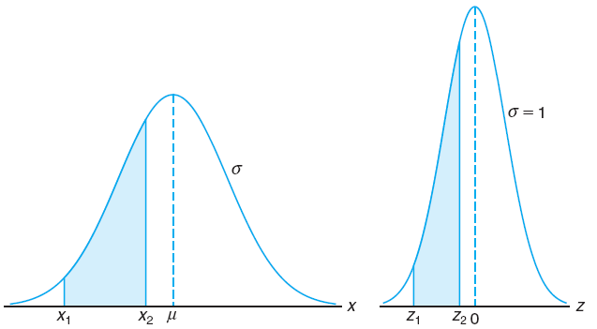
Chapter 6.3
Areas Under the Normal Curve
Area Under the Normal Curve
The distribution of a normal random variable with mean 0 and variance 1 is called a standard normal distribution.

Slide 7
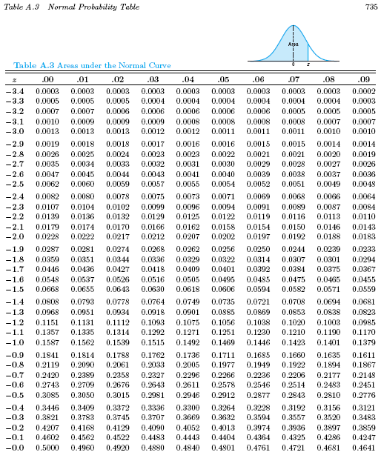
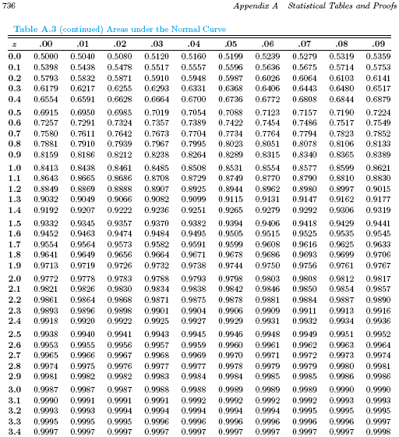
Chapter 6.3
Areas Under the Normal Curve
Table A.3 Normal Probability Table

Slide 8
Chapter 6.3
Areas Under the Normal Curve
Interpolation
Interpolation is a method of constructing new data points within the range of a discrete set of known data points.
Examine the following graph. Two data points are known, which are (a,f(a)) and (b,f(b)).
If a value of c is given, with a < c < b, then the value of f(c) can be estimated.
If a value of f(c) is given, with f(a) < f(c) < f(b), then the value of c can be estimated.

Slide 9
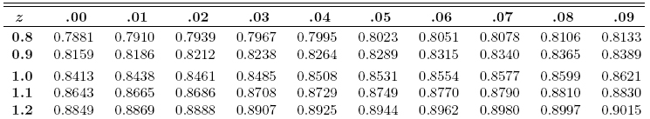
Chapter 6.3
Areas Under the Normal Curve
Interpolation
P(Z < 1.172)? Answer: 0.8794
P(Z < z) = 0.8700, z = ? 1.126

Slide 10
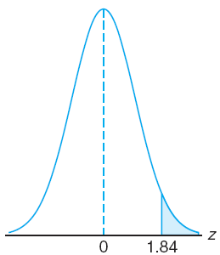
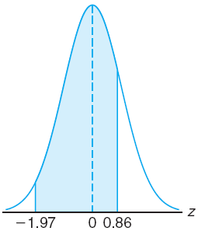
Chapter 6.3
Areas Under the Normal Curve
Area Under the Normal Curve
Given a standard normal distribution, find the area under the curve that lies (a) to the right of z = 1.84 and (b) between z = –1.97 and z = 0.86.

Slide 11
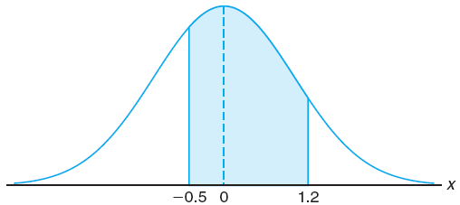
Chapter 6.3
Areas Under the Normal Curve
Area Under the Normal Curve
Given a random variable X having a normal distribution with μ = 50 and σ = 10, find the probability that X assumes a value between 45 and 62.

Slide 12
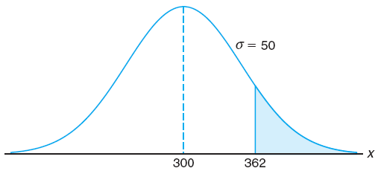
Chapter 6.3
Areas Under the Normal Curve
Area Under the Normal Curve
Given that X has a normal distribution with μ = 300 and σ = 50, find the probability that X assumes a value greater than 362.

Slide 13
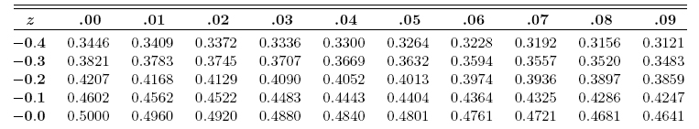
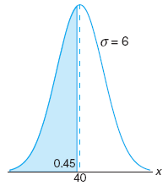
Chapter 6.3
Areas Under the Normal Curve
Area Under the Normal Curve
Given a normal distribution with μ = 40 and σ = 6, find the value of x that has (a) 45% of the area to the left, and (b) 14% of the area to the right.

Slide 14
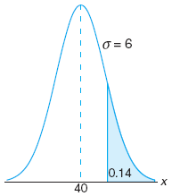
Chapter 6.3
Areas Under the Normal Curve
Area Under the Normal Curve
Given a normal distribution with μ = 40 and σ = 6, find the value of x that has (a) 45% of the area to the left, and (b) 14% of the area to the right.

Slide 15
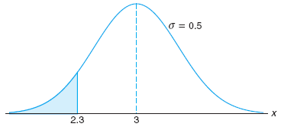
Chapter 6.4
Applications of the Normal Distribution
Applications of the Normal Distribution
A certain type of storage battery lasts, on average, 3.0 years, with a standard deviation of 0.5 year. Assuming that the battery lives are normally distributed, find the probability that a given battery will last less than 2.3 years.

Slide 16
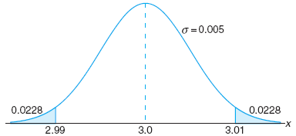
Chapter 6.4
Applications of the Normal Distribution
Applications of the Normal Distribution
In an industrial process the diameter of a ball bearing is an important component part. The buyer sets specifications on the diameter to be 3.0 ± 0.01 cm. All parts falling outside these specifications will be rejected.
It is known that in the process the diameter of a ball bearing has a normal distribution with mean 3.0 and standard deviation 0.005.
On the average, how many manufactured ball bearings will be scrapped?

Slide 17
Chapter 6.4
Applications of the Normal Distribution
Applications of the Normal Distribution
A certain machine makes electrical resistors having a mean resistance of 40 Ω and a standard deviation of 2 Ω. It is assumed that the resistance follows a normal distribution.
What percentage of resistors will have a resistance exceeding 43 Ω if:
the resistance can be measured to any degree of accuracy.
the resistance can be measured to the nearest ohm only.
As many as 6.68%–4.01% = 2.67% of the resistors will be accepted although the value is greater than 43 Ω due to measurement limitation

Slide 18
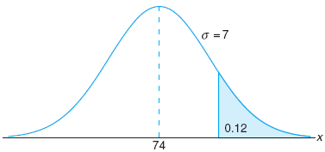
Chapter 6.4
Applications of the Normal Distribution
Applications of the Normal Distribution
The average grade for an exam is 74, and the standard deviation is 7. If 12% of the class are given A’s, and the grade are curved to follow a normal distribution, what is the lowest possible A and the highest possible B?
Lowest possible A is 83
Highest possible B is 82

